Slide 1
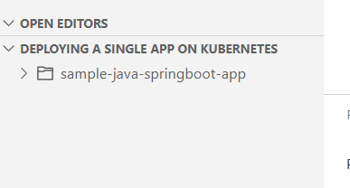
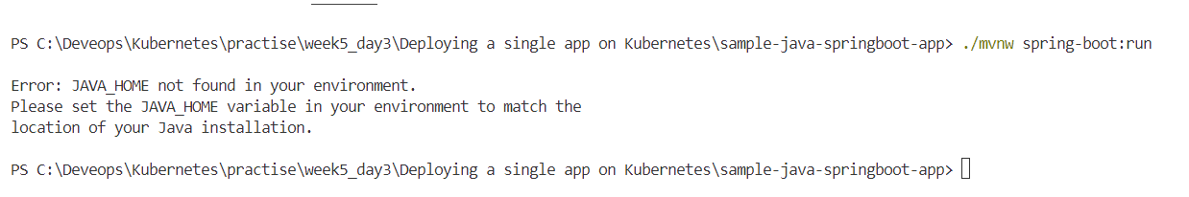
Deploying a single app on Kubernetes
TASK 1
In this task, we will run the containerized Java application on a Kubernetes cluster.
Sample Application
Clone the folder as mentioned
To run this application, you can execute the below command:
./mvnw spring-boot:run

Slide 2
Create a new file called Dockerfile in the root directory and add the code below:
FROM openjdk:17-jdk-alpine
WORKDIR /app
EXPOSE 8080
COPY .mvn/ .mvn
COPY mvnw pom.xml ./
RUN ./mvnw dependency:go-offline
COPY src ./src
CMD ["./mvnw", "spring-boot:run"]

Slide 3
Modified docker file
FROM openjdk:17-jdk-alpine
WORKDIR /app
COPY .mvn/ .mvn
COPY mvnw pom.xml ./
RUN dos2unix mvnw && chmod +x mvnw
RUN sh ./mvnw dependency:go-offline
COPY src ./src
EXPOSE 8080
CMD ["sh", "./mvnw", "spring-boot:run"]

Slide 4
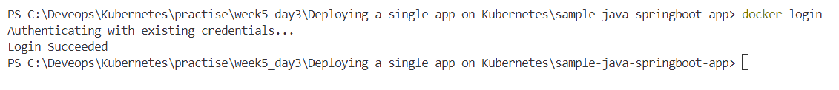
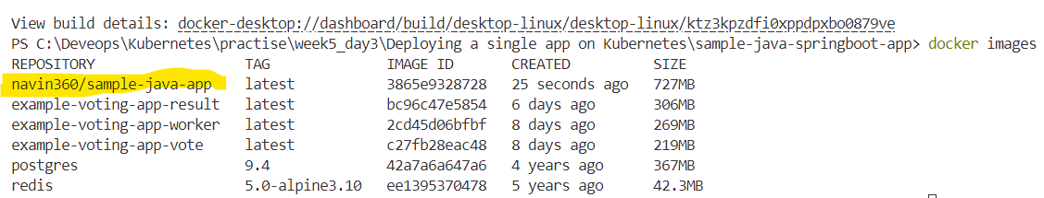
Docker login
Create the docker image using docker build command.

Slide 5
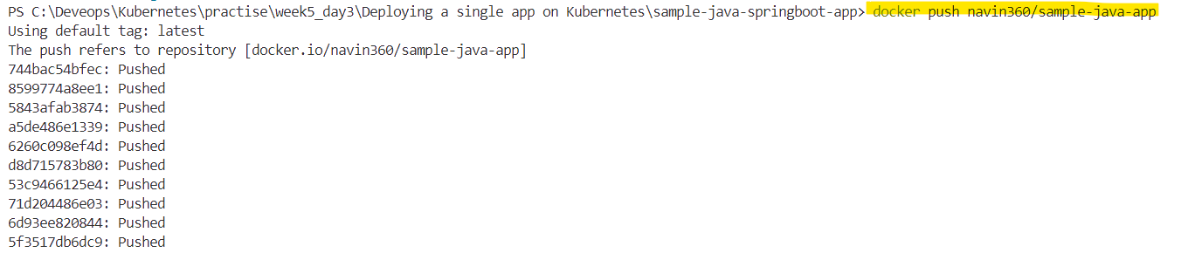
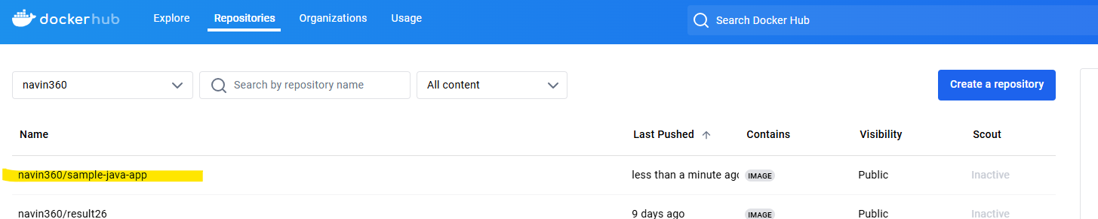
Push the image to DockerHub registry.

Slide 6
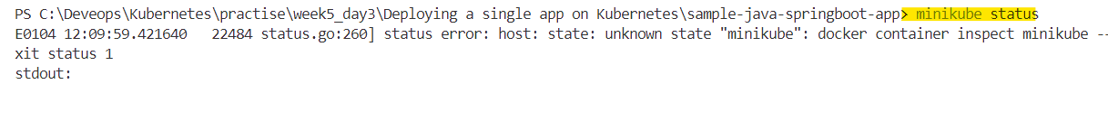
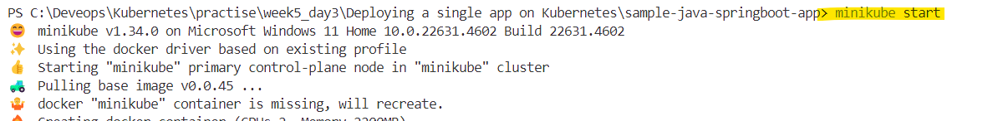

Slide 7
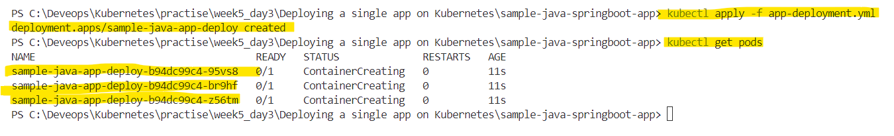
Verify the Pods are running
apiVersion: apps/v1
kind: Deployment
metadata:
name: sample-java-app-deploy
labels:
app: sample-java-app
spec:
replicas: 3
selector:
matchLabels:
app: sample-java-app
template:
metadata:
name: sample-java-app
labels:
app: sample-java-app
spec:
containers:
- name: sample-node-app
image: saurabhd2106/sample-java-app
ports:
- containerPort: 8080
App-deployment.yml

Slide 8
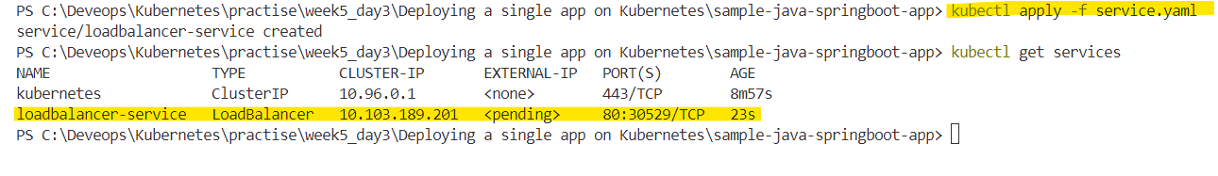
apiVersion: v1
kind: Service
metadata:
name: loadbalancer-service
spec:
type: LoadBalancer
ports:
- port: 80
targetPort: 8080
selector:
app: sample-java-app
Service file

